Slide 1

A Probabilistic Approach to Pokémon Platinum
Luc van den Enden
453142@student.fontys.nl

Slide 2
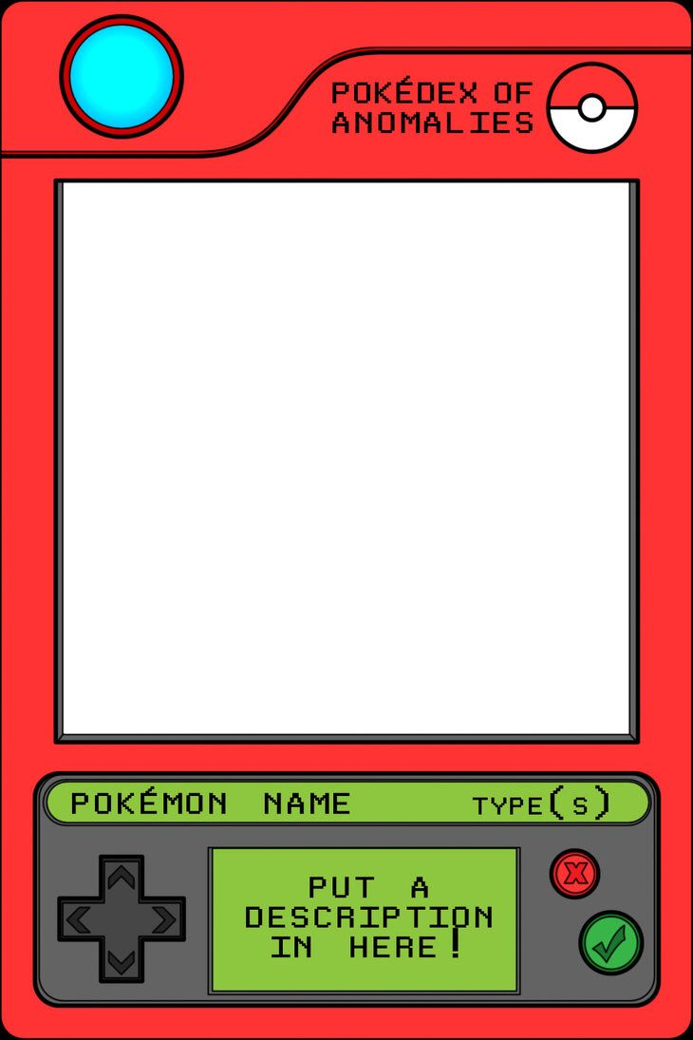
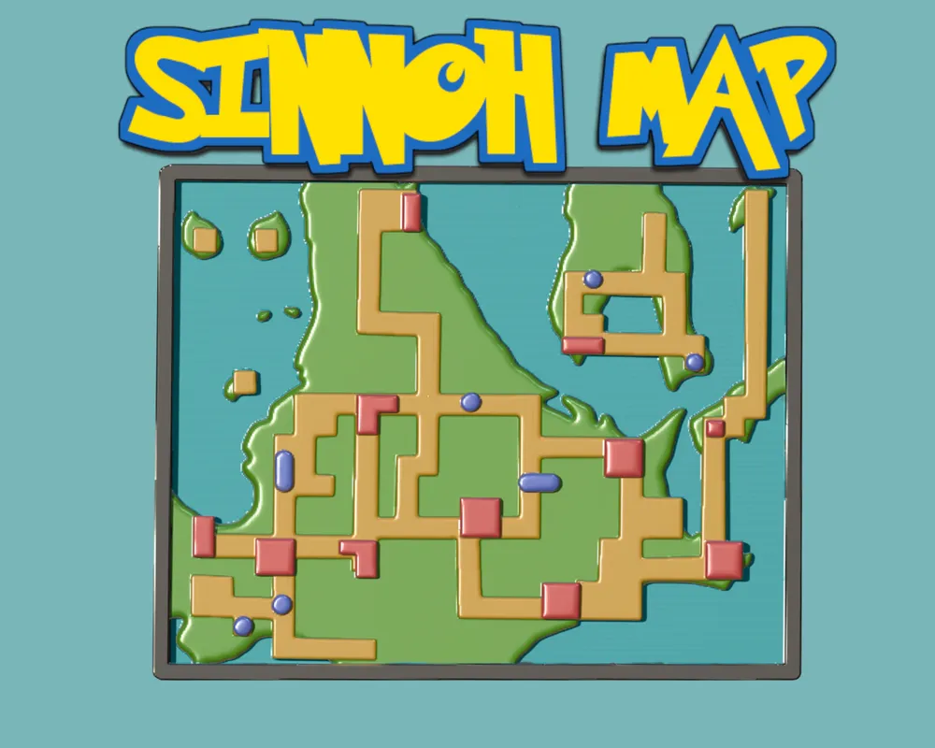
Contents
Domain Understanding
Pokémon ≡ Math
Preliminary Research
Experimental Design / Results

Slide 3
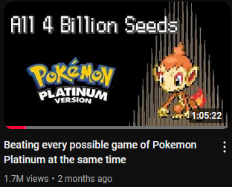
Inspiration
Video about abusing RNG
Exhaustively and statistically find a sequence of inputs to advance the game
Result is action sequence that always beats the game, ALWAYS
I wondered: what if we treat it as truly random?
https://www.youtube.com/watch?v=jNMWkD5VsZ8
https://github.com/KeeyanGhoreshi/PlatinumSimulator
https://github.com/KeeyanGhoreshi/PokemonPlatinumSingleSequence

Slide 4

Domain Understanding
Game Freak, Media Company, ca. 1980
Manga, Anime, TCG and Digital Game
Short for Pocket Monster
Digital Game releases are referred to by generations, or gen for short
Gen 4 = focus point
https://en.wikipedia.org/wiki/Pokémon

Slide 5

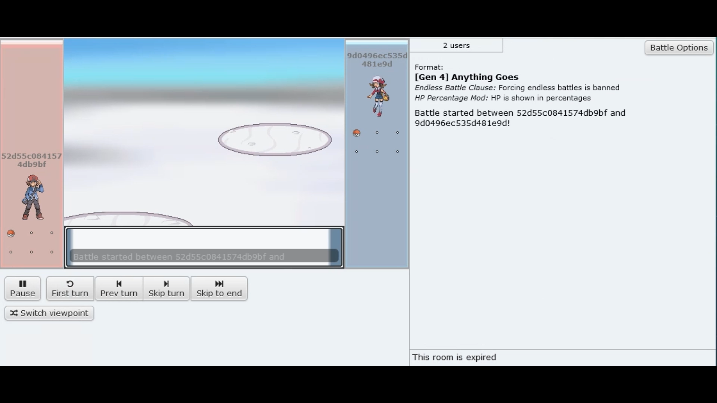

Domain Understanding
But what is a Pokémon? Informally…
A fictional monster
Has some stats that describe it
Can battle other Pokémon
Resource available to an agent playing the game

Slide 6

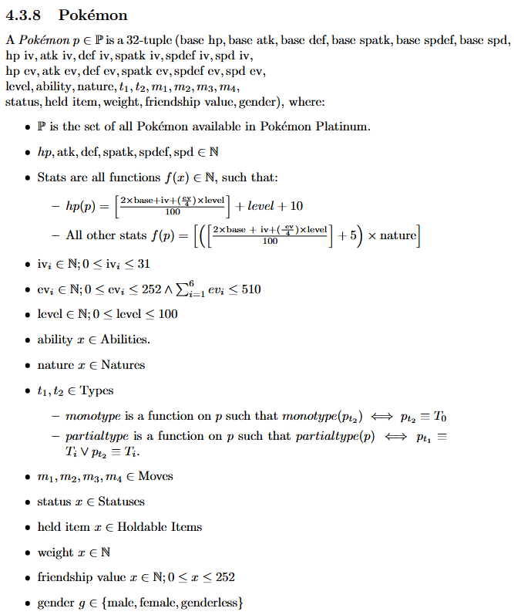

Pokémon ≡ Math research_lvde\experiments\defining_a_proper_battle_observation_space.ipynb research_lvde\tex\out\main.pdf#page=17

Slide 7
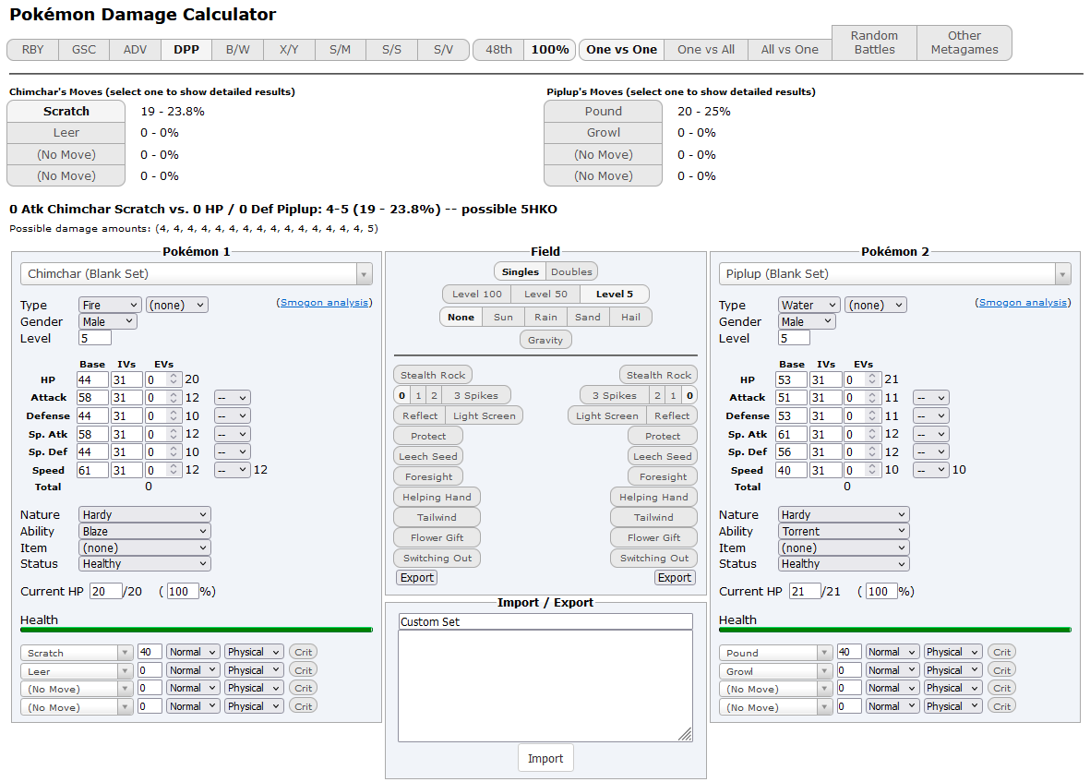
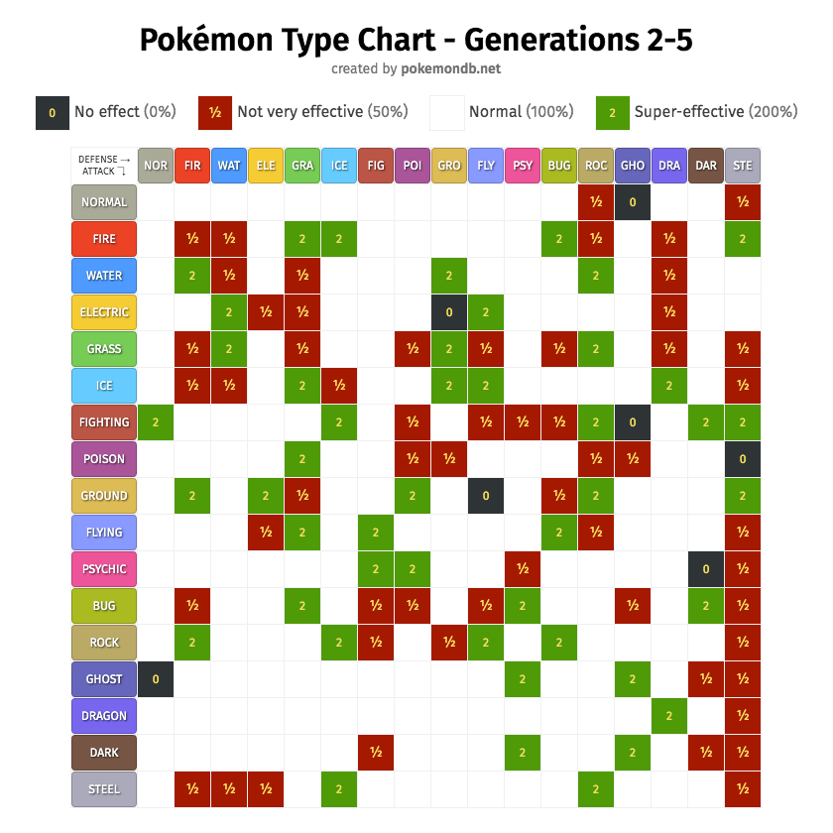
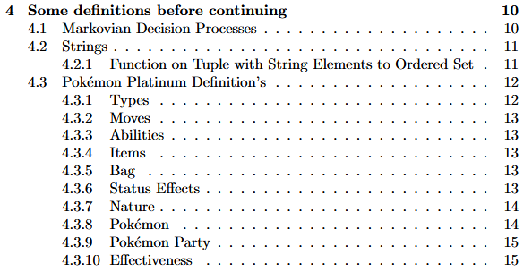
Pokémon == Math research_lvde\experiments\defining_a_proper_battle_observation_space.ipynb https://bulbapedia.bulbagarden.net/wiki/Damage https://img.pokemondb.net/images/typechart-gen2345.png https://calc.pokemonshowdown.com/?gen=4
But wait, there is more!

Slide 8

Pokémon ≡ Math
For the sake of preserving sanity, we will discuss details throughout

Slide 9

Preliminary Research research_lvde\tex\out\main.pdf#page=20
How can Markovian decision processes be implemented in Python?
What are popular (both old and new) reinforcement learning approaches?
How can we efficiently simulate Pokémon Platinum?

Slide 10

Preliminary Research research_lvde\tex\out\main.pdf#page=17 How can Markovian decision processes be implemented in Python?
What are Markovian decision processes and what is their relation towards reinforcement learning?
What tools, libraries, or frameworks are available to assist in programming Markovian decision processes?

Slide 11
Preliminary Research research_lvde\tex\out\main.pdf#page=19 What are popular (both old and new) reinforcement learning approaches?
Exploration vs Exploitation
Value-based vs Policy-based approaches
On-policy vs Off-policy approaches
Model-based vs Model-free approaches
Action-Cost function and Reward Function
Comparative Analysis on Popular Reinforcement Learning Approaches
How do these approaches compare in terms of their strengths and weaknesses?
Are there supporting methods, such as statistical techniques or others, that could enhance the effectiveness of reinforcement learning?

Slide 12

Preliminary Research research_lvde\tex\out\main.pdf#page=23 How can we efficiently simulate Pokémon Platinum?
What does "efficiency" entail in this context, particularly regarding time complexity (and potentially space complexity)?
What existing software products or tools are available for this purpose, and how can they be utilized or adapted?

Slide 13
To summarize the conclusions…
How can Markovian decision processes be implemented in Python?
See next slide
What are popular (both old and new) reinforcement learning approaches?
Q-Learning
Table based
Network based
SARSA
PPO
Soft Actor-Critic
Deep Deterministic Policy Gradient
Trust Region Policy Optimization
MCTS
Temporal Difference Learning
How can we efficiently simulate Pokémon Platinum?
See next slide

Slide 14
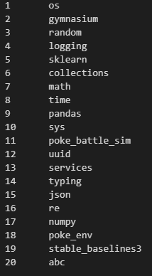
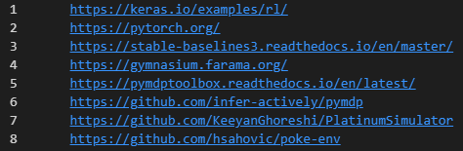
To summarize the conclusions…
Packages used
Sources used
@book{rn2022aima,
title = {Artificial Intelligence: A Modern Approach (4th Edition)},
author = {Stuart J. Russell and Peter Norvig},
year = {2022},
url = {https://aima.cs.berkeley.edu/global-index.html},
publisher = {Pearson},
isbn = {9781292401133},
}

Slide 15
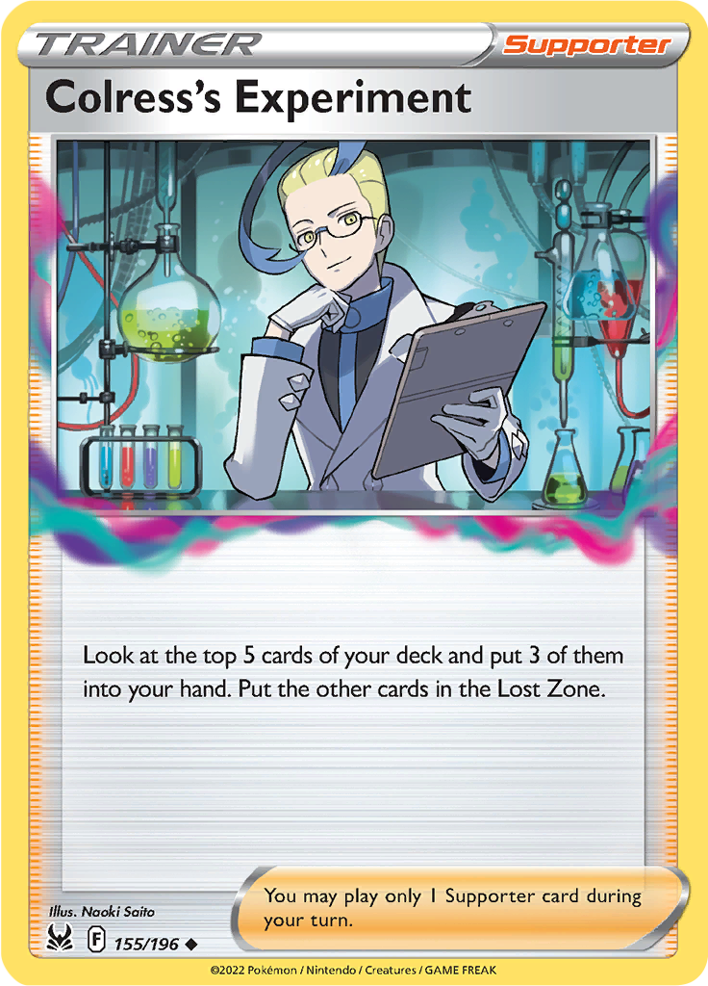
Experimental Design
Start off simple
Increase environment complexity gradually
Order of experiments
Initial Pokémon battling environment
DQN on starter battle
MCTS on starter battle
Defining proper observation space
Gauntlet environment

Slide 16



Initial Pokémon battling environment
Informally…
3 Pokémon
Each have 2 unique moves
Single’s battle
No items
No battlefield changes
Type effectiveness does not come in to play

Slide 17
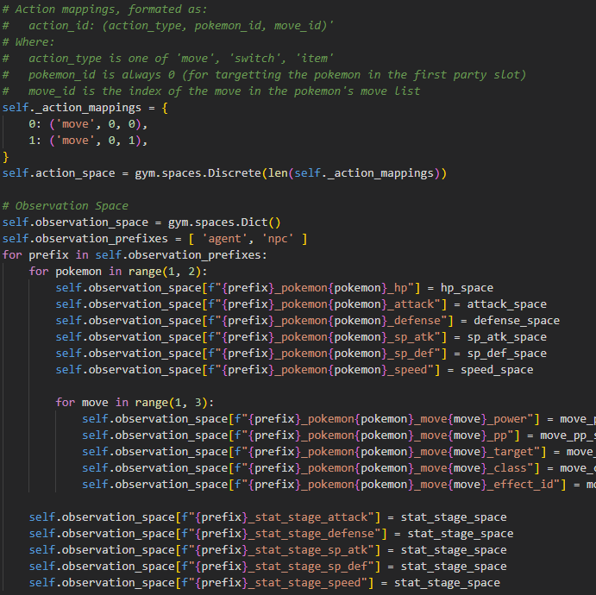
Initial Pokémon battling environment
More formally…
See image
All spaces are discrete
Reward =
Win? +1
Loss? -1
Else? -0.01

Slide 18
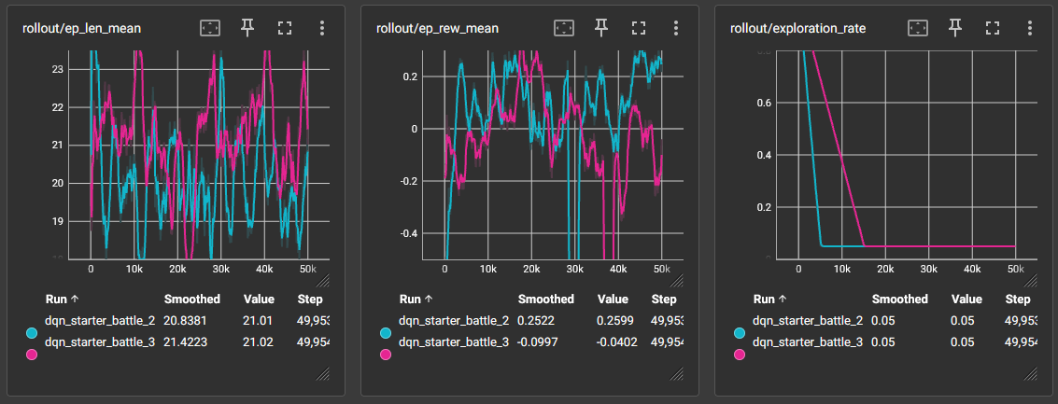
DQN on starter battle
exploration_rate = 0.1 / 0.2 n_timesteps = 10.000 time_to_train = > 1 minute

Slide 19
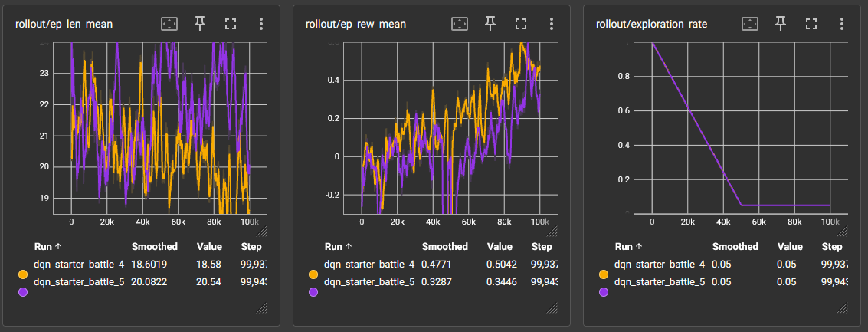
DQN on starter battle
exploration_rate = 0.5 n_timesteps = 100.000 time_to_train = ~3.3 minutes

Slide 20
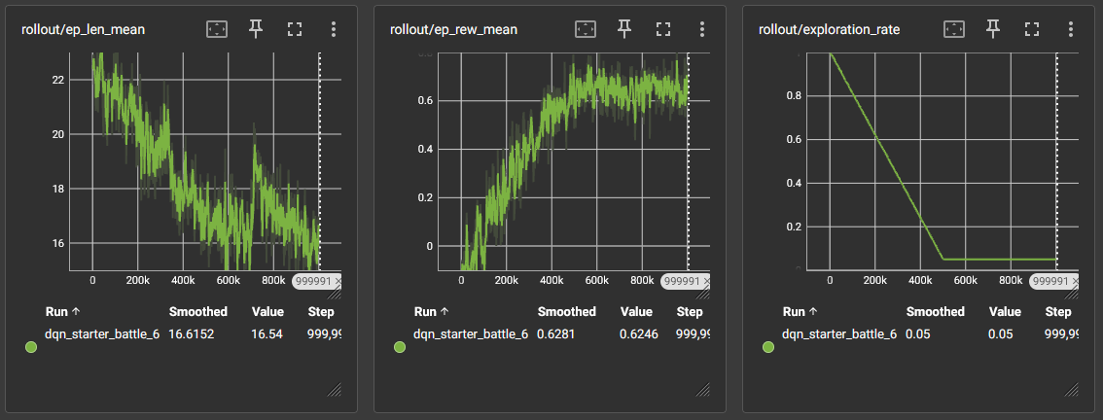
DQN on starter battle
exploration_rate = 0.5 n_timesteps = 1.000.000 time_to_train = ~35 minutes

Slide 21
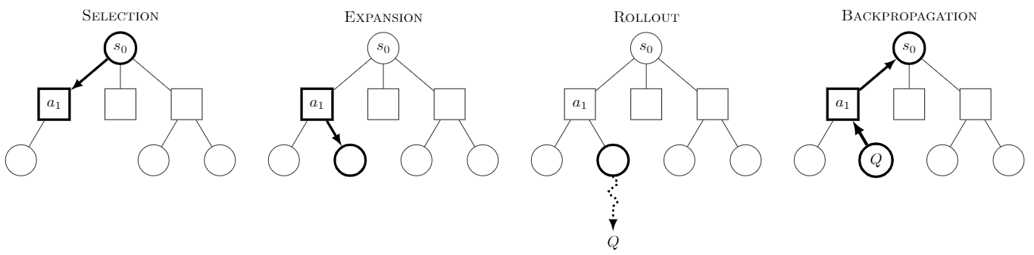
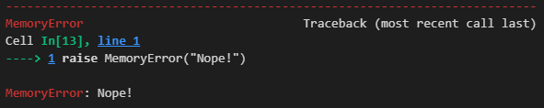
MCTS on starter battle

Slide 22
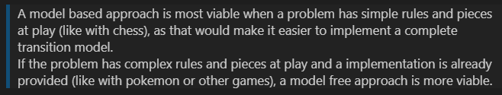
But why?
To put it simply
Smart solutions (like storing state nodes in files) would eliminate most space issues that come with MCTS
Choose to continue with model-free

Slide 23
Defining proper observation space
Start with informal definition
Use data to verify limits
Choose fitting space representation

Slide 24
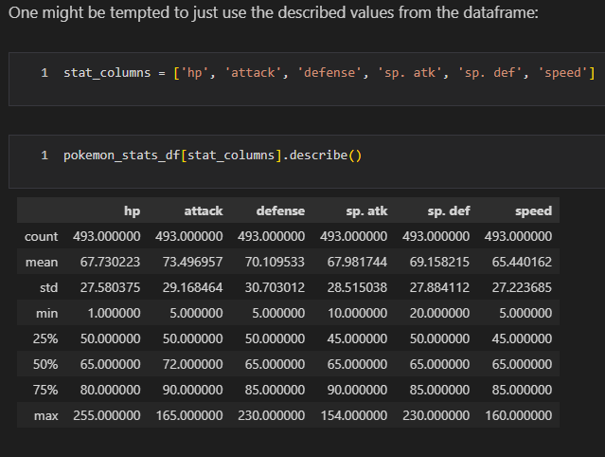
Defining proper observation space
For example: stats

Slide 25
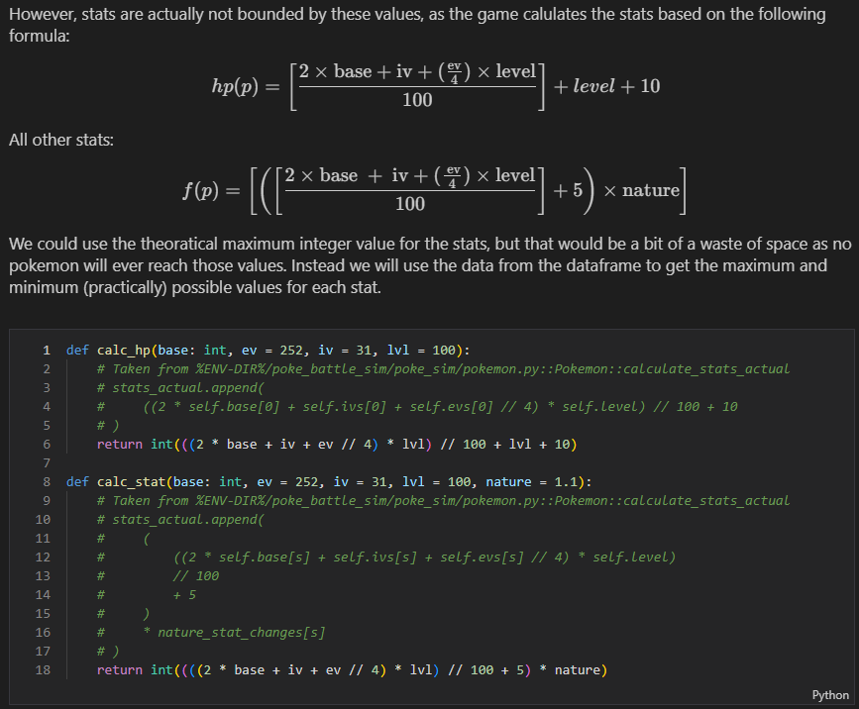
Defining proper observation space
For example: stats
Base stats

Slide 26
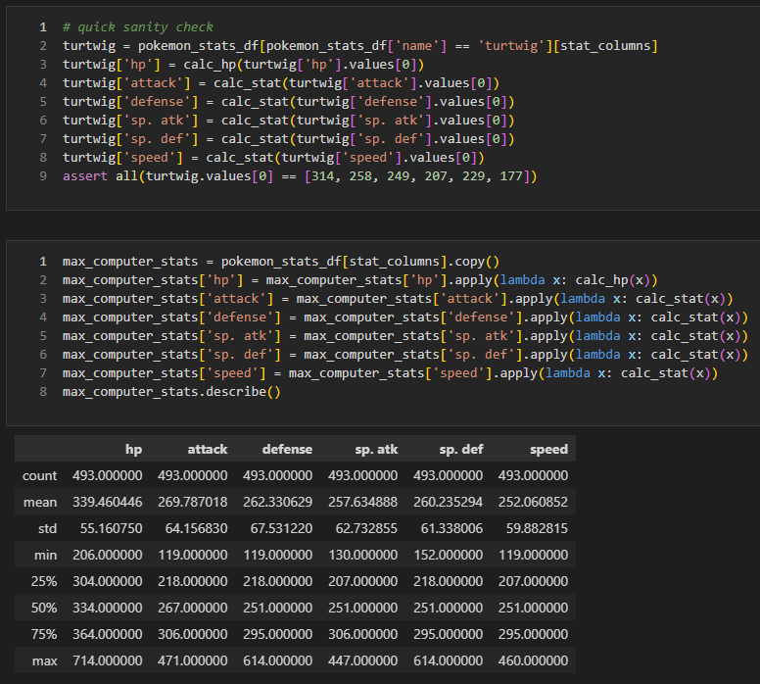
Defining proper observation space
For example: stats
Base stats
Computed stats

Slide 27
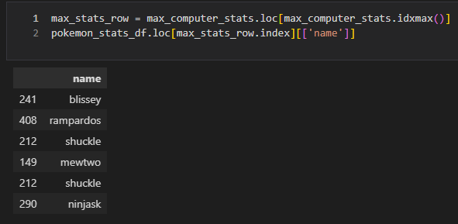
Defining proper observation space
For example: stats
Base stats
Computed stats
Verify expected

Slide 28
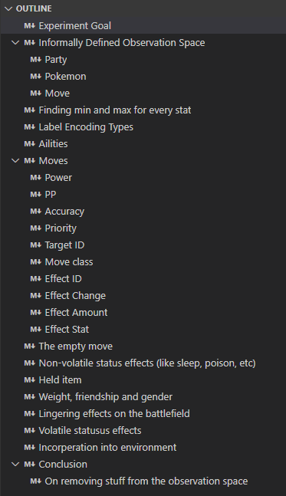
Defining proper observation space
Rince and repeat for every unit in observation sapce

Slide 29
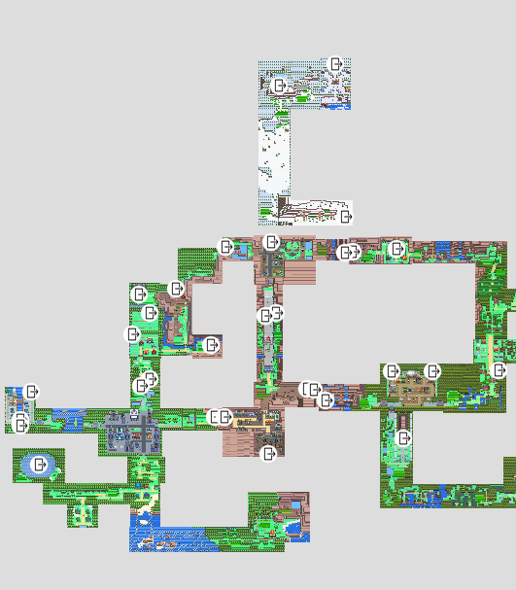
Gauntlet Environment
Have agent traverse locations
Locations have encounters & trainers
Upon arrival at location:
Agent gets 1 random encounter
Agent fights all trainers
Once all trainers are defeated, move to next location
Beating all locations = max reward.
Did not finish

Slide 30

To conclude my study
Learned about RL and MDP’s
Gained understanding of probability theory
Learned what it takes to create RL environments
Seen limitations of approaches
Hope this was inspiring

